Slide 1

Data Extraction with Automation: A Comprehensive Guide
Learn how to extract data and automate the process
Notes:
In this presentation, we will explore the latest trends in data extraction with automation. We will start with an overview of APIs, how to extract data from them and then move on to automating data extraction. Finally, we will look at case studies and applications of data extraction.

Slide 2

Agenda Items
Data Extraction from APIs
Automating Data Extraction
Case Studies and Applications of Data Extraction
Notes:
We will start by exploring the basics of extracting data from APIs. We will then move on to automating data extraction and explore the tools and techniques that can be used. Finally, we will look at some real-world examples of large-scale data extraction projects.

Slide 3
Data Extraction from APIs
Notes:
APIs are used by many organizations to provide access to their data. In this section, we will explore how to extract data from APIs, including an introduction to APIs, how to extract data via REST APIs, and tools that can be used for API data extraction. We will also discuss the challenges that can be encountered in API data extraction.

Slide 4
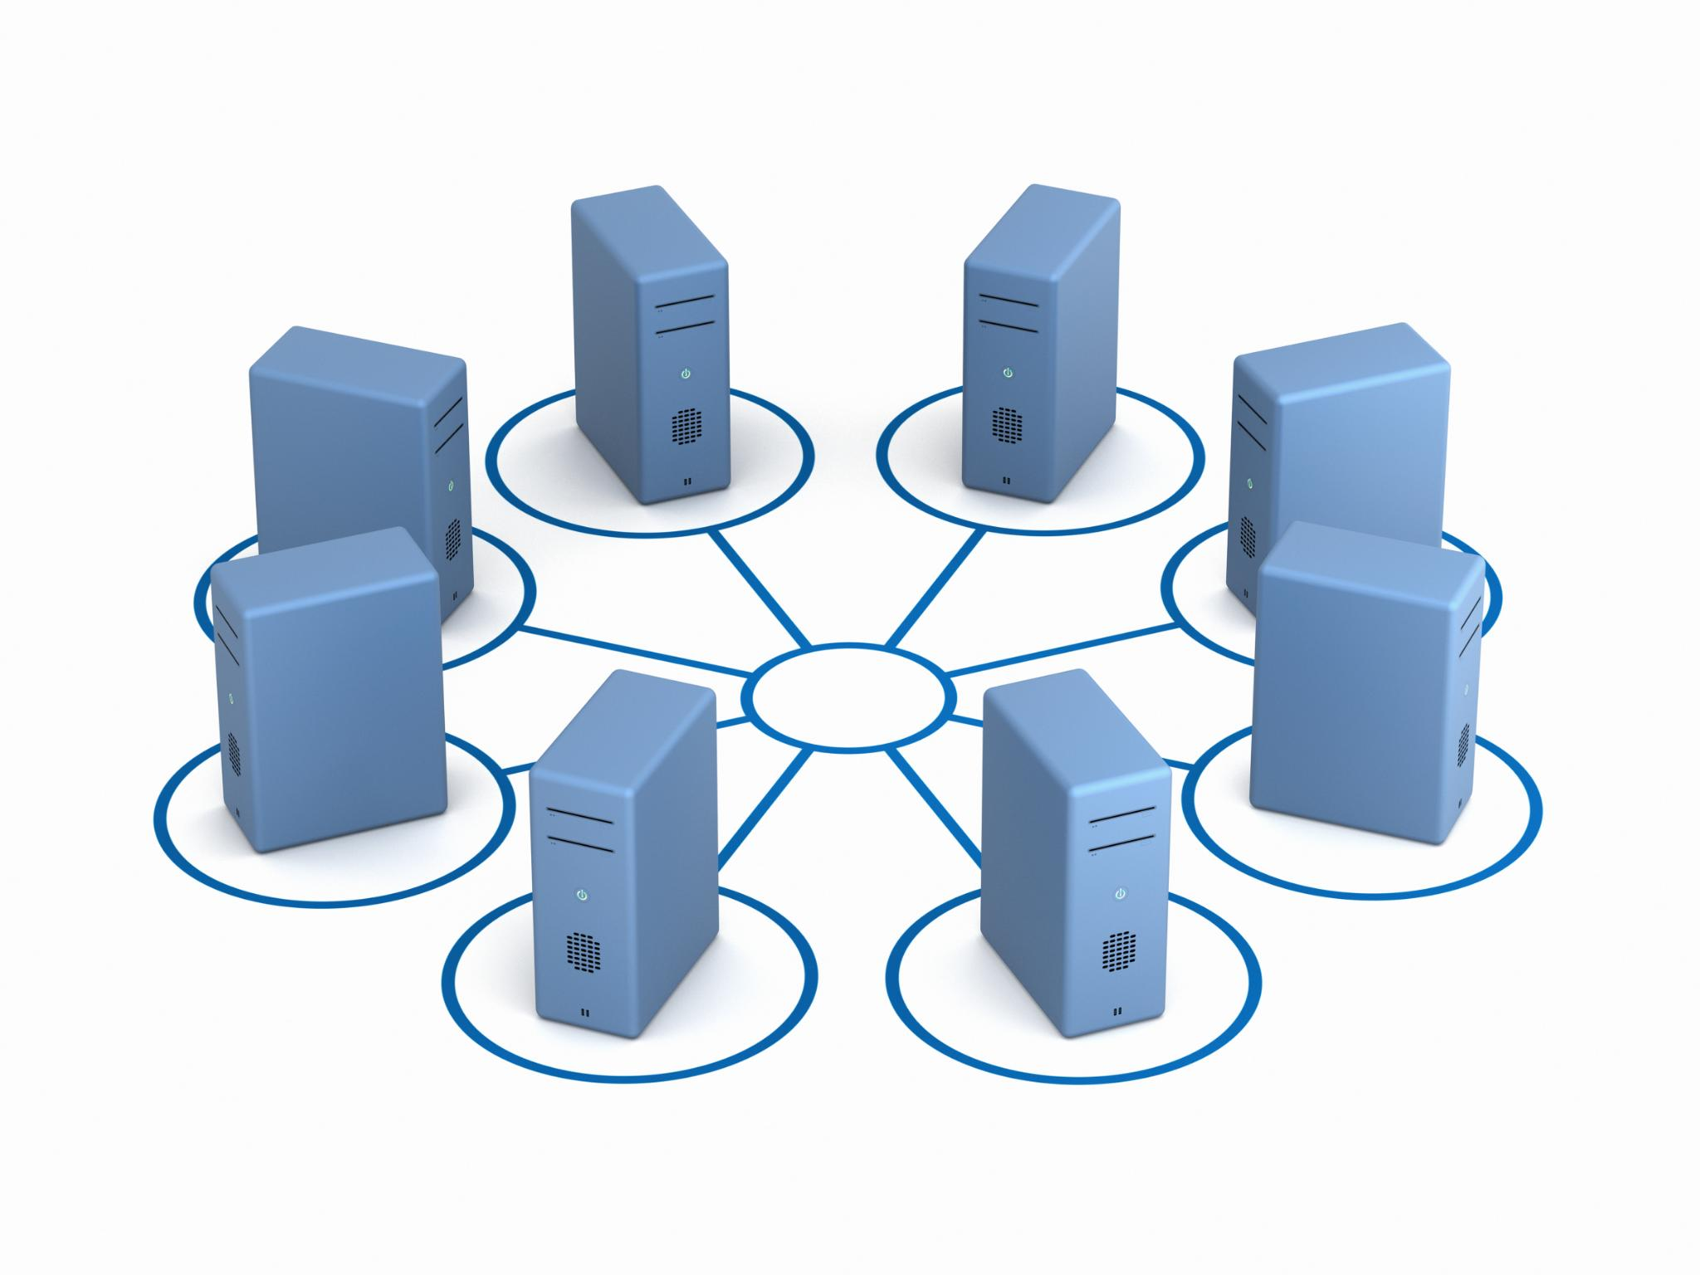
Introduction to APIs
What are APIs?
  APIs, or Application Programming Interfaces, are a set of protocols, routines, and tools for building software and applications. They allow applications to communicate with each other and exchange data.
How do APIs work?
  APIs work by establishing a connection between two applications and allowing them to exchange data in a standardized format. This connection is usually made using a set of protocols, such as HTTP, REST, or SOAP.
Notes:
APIs, or Application Programming Interfaces, provide a way for applications to communicate with each other and exchange data. In this slide, we will provide an overview of what APIs are and how they work.

Slide 5

Extracting data via REST APIs
What are REST APIs?
  REST APIs are a common type of API used for data extraction. They use HTTP requests to communicate with servers and retrieve data in a standardized way.
Data Extraction via REST APIs
  Data can be extracted via REST APIs by making HTTP requests to the server and receiving data in a standardized format such as JSON or XML.
Tools for Extracting Data via REST APIs
  There are several tools available for extracting data via REST APIs, such as Postman, cURL, and Python libraries like Requests and Beautiful Soup.
Notes:
REST APIs are one of the most common types of APIs used for data extraction. In this slide, we will explore how to extract data via REST APIs and the tools that can be used for this purpose.

Slide 6

Using tools for API data extraction
Requests Library
  Requests is a Python library used for making HTTP requests to web services. It is a simple yet powerful tool for API data extraction.
Beautiful Soup
  Beautiful Soup is a Python library used for web scraping and parsing HTML and XML documents. It is commonly used for extracting data from web pages and APIs.
Postman
  Postman is a commercial tool used for testing, documenting, and debugging APIs. It provides a user-friendly interface for making API requests and analyzing responses.
Notes:
There are various tools that can be used for API data extraction, including Python libraries like Requests and Beautiful Soup, and commercial tools like Postman and SoapUI. In this slide, we will explore some of the most popular tools for API data extraction.

Slide 7

Challenges in API data extraction
Rate Limiting
  APIs can limit the number of requests you can make in a given time period, known as rate limiting. This can slow down data extraction and even cause errors.
Authentication
  APIs often require authentication, which can involve complex processes such as OAuth. Implementing authentication can be challenging, and errors can occur if it is not done correctly.
Handling Errors
  API data extraction can be prone to errors, such as network errors, server errors, and data parsing errors. Proper error handling is necessary to ensure that the data extraction process is reliable and error-free.
Notes:
While APIs provide a convenient way to access data, there can be challenges in extracting data from them. In this slide, we will discuss some of the challenges that can be encountered in API data extraction, such as rate limiting, authentication, and handling errors.

Slide 8
Automating Data Extraction
Notes:
Automating data extraction can save time and reduce the risk of errors. In this section, we will explore the tools and techniques that can be used for automating data extraction. We will also discuss the challenges that can be encountered in automation.

Slide 9

Tools for Automation
Selenium
  Selenium is a popular web scraping tool for automating data extraction from web pages. It is an open-source tool and supports various programming languages, making it a go-to choice for many developers.
BeautifulSoup and Scrapy
  BeautifulSoup and Scrapy are Python libraries used for web scraping and data extraction. They are easy to use and provide powerful tools for parsing HTML and XML documents.
UiPath and Automation Anywhere
  UiPath and Automation Anywhere are popular commercial tools used for automating repetitive tasks. They provide a range of features for automating various processes, including data extraction, data processing, and report generation.
Notes:
There are various tools that can be used for automating data extraction, including web scraping tools like Selenium, Python libraries like BeautifulSoup and Scrapy, and commercial tools like UiPath and Automation Anywhere. In this slide, we will explore some of the most popular tools for automation.

Slide 10

Challenges in Automation
Handling Complex Websites
  Automating data extraction from complex websites can be challenging due to the complexity of web pages and the variable nature of the data. Some websites may have dynamic content that changes frequently, making it difficult to extract data accurately.
Managing Cookies and Sessions
  Cookies and sessions are used by websites to store user data and maintain session state. When automating data extraction, it is important to manage cookies and sessions properly to avoid detection and ensure that data is extracted accurately.
Avoiding Detection
  Websites may use anti-automation techniques to detect and block automated data extraction. It is important to use techniques such as rotating IP addresses and user agents to avoid detection and ensure that data is extracted accurately.
Notes:
While automation can save time and reduce errors, there can be challenges in automating data extraction. In this slide, we will discuss some of the challenges that can be encountered in automation, such as handling complex websites, managing cookies and sessions, and avoiding detection.

Slide 11
Case Studies and Applications of Data Extraction
Notes:
In this section, we will look at some real-world examples of large-scale data extraction projects. We will explore the challenges faced and the lessons learned from these projects.

Slide 12

Real-world examples
Price Monitoring
  Large-scale data extraction can be used to monitor prices in various industries, including e-commerce, retail, and travel, allowing businesses to monitor competitor pricing and adjust their own pricing strategies accordingly.
Lead Generation
  Data extraction can be used to identify potential customers and generate leads for businesses across various industries, including real estate, healthcare, and finance.
Sentiment Analysis
  Data extraction can be used to collect and analyze large amounts of data from social media and other sources to gain insights into customer sentiment and preferences, allowing businesses to make data-driven decisions.
Notes:
There are many applications of data extraction, including price monitoring, lead generation, sentiment analysis, and more. In this slide, we will explore some real-world examples of large-scale data extraction projects.

Slide 13

Challenges and lessons learned from large-scale data extraction projects
Managing Large Volumes of Data
  One of the main challenges in large-scale data extraction projects is managing large volumes of data. This can include issues with storage, organization, and retrieval of data.
Dealing with Multiple Sources
  Another challenge in large-scale data extraction projects is dealing with multiple sources. This can include issues with data compatibility, data consistency, and data accuracy.
Ensuring Data Quality
  Ensuring data quality is an ongoing challenge in large-scale data extraction projects. This can include issues with data completeness, data accuracy, and data timeliness.
Notes:
Large-scale data extraction projects can present unique challenges, such as managing large volumes of data, dealing with multiple sources, and ensuring data quality. In this slide, we will discuss some of the challenges and lessons learned from large-scale data extraction projects.

Slide 14
Conclusion
  Data extraction with automation offers significant benefits to organizations, allowing them to gain valuable insights and make more informed decisions by leveraging APIs, automating data extraction, and learning from real-world examples.
Notes:
Data extraction with automation is a rapidly-evolving field that offers significant benefits to organizations. By leveraging APIs, automating data extraction, and learning from real-world examples, organizations can gain valuable insights and make more informed decisions.

